Slide 1


Slide 2

Laurus Labs Limited | Company Overview
Company overview
Financial overview – last three years
When founded? Founded in 2005; integrated pharmaceutical and CDMO platform.
Key products / services: APIs, finished dosage formulations, small-molecule CDMO and Bio CDMO.
Promoter & promoter group holding: 27.49% as of 31-Mar-2026.
Listing details: NSE: LAURUSLABS; BSE: 540222; model market cap: ₹53,592 Cr.
Registered office: Parawada, Andhra Pradesh; corporate office: Hyderabad; core manufacturing: Visakhapatnam.
Growth drivers: CDMO outsourcing, complex molecules, formulations, peptides/fermentation and advanced modalities.
Risks: regulation, pricing pressure, capex execution and innovation.
 | FY24A | FY25A | FY26A
Revenue | ₹5,041 | ₹5,554 | ₹6,813
EBIT | ₹414 | ₹685 | ₹1,346
PAT | ₹161 | ₹358 | ₹889
ROCE | 7.8% | 11.8% | 19.6%
ROE | 3.9% | 8.0% | 16.8%
D/E | 0.6x | 0.6x | 0.4x
Industry overview
Current Market size and forecast size: India domestic pharma market: ₹5.30 lakh Cr in FY26; projected ₹12.47 lakh Cr by 2030 (implied ~24% CAGR).
Growth rate ( %) over the forecast period​; 14.4% CAGR (2025–2031)
Market share: Laurus Labs does not disclose a consolidated CDMO market-share figure; CDMO contributed 31% of FY26 revenue (₹2,080 Cr).
Relevant peers: Divi’s, Torrent, Sun Pharma, Zydus, Cipla and Mankind.
Regulation: CDSCO/DCGI; NPPA/DPCO price controls; PLI and Biopharma SHAKTI support domestic manufacturing/R&D.
Growth drivers: healthcare demand, exports, complex generics, CDMO outsourcing, localisation and R&D investment.
Key risks: US/EU regulatory actions, pricing pressure, US generic erosion, geopolitical/supply-chain issues and high capex intensity.
Revenue Growth Story
Revenue growth assumption %:
Primary forecast: 15% consolidated revenue growth p.a. in FY27E–FY31E.
(1) Rationale: Moderated from FY26 revenue growth of 23%; assumes sustained CDMO momentum and continued scale-up while normalising growth as the base expands.
(2) Scenario 2: 20% small-molecule CDMO + 20% Bio CDMO + 10% Affordable Medicines growth; FY31 revenue ₹12,798 Cr.
(3) Operating anchor: Forecast EBITDA margin 26% vs. FY26A 26.8%; gross margin held at 60%.
Prepared by: [Saisha Hemrajani] | Target: Laurus Labs Ltd | Valuation date: 31-Mar-2026
1

Slide 3
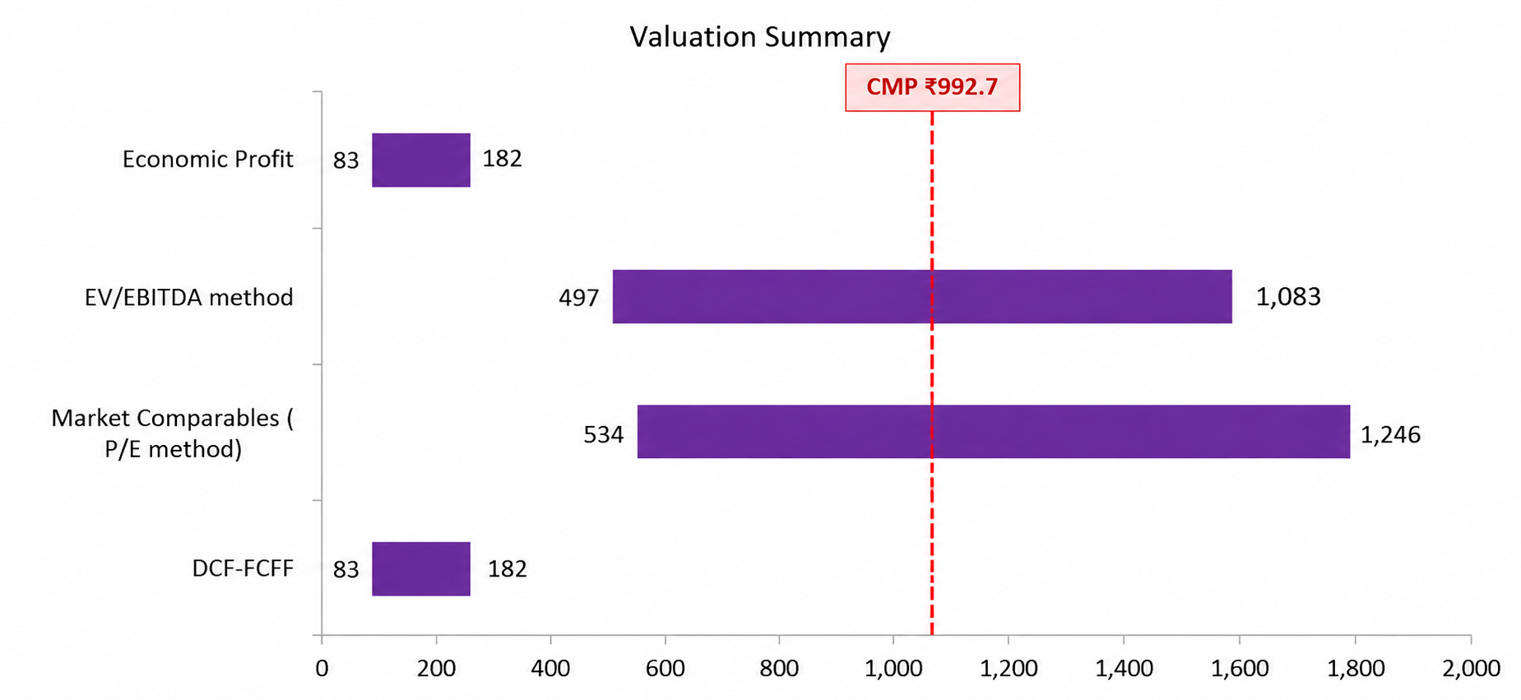
Laurus Labs | Valuation Overview
Football Field – DCF, Market Comparables & Economic Profit
₹ per share
Key assumptions
Football field (value per share, Rs)
DCF assumptions
WACC: 14.0%
Terminal growth: 4.0%
Comparable selection
Peers: Divi’s Laboratories, Torrent Pharma, Sun Pharma, Zydus Lifesciences, Cipla, Mankind Pharma.
Why: business overlap in Indian pharma, APIs/formulations/CDMO, scale and comparable return characteristics.
Multiples: P/E and EV/EBITDA; median peer multiples = 41.6x and 22.5x.
Implied point values: P/E ₹683.5/share; EV/EBITDA ₹721.5/share.
CMP: ₹992.7
3-method reference value: ₹304.5
Implied downside: 69.3%
Recommendation: SELL
Prepared by: [Saisha Hemrajani] | Target: Laurus Labs Ltd | Valuation date: 31-Mar-2026
2

Slide 4
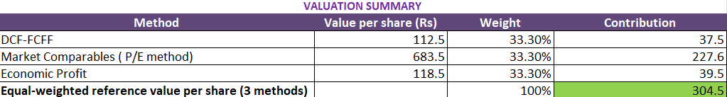
Laurus Labs | Investment Rationale
Why we say SELL
CMPS:
₹992.70 per share (CMP as of 30-Mar-2026)
Fair Value ( Based on all methods)
₹304.5
69.3% below the valuation-date CMP
Recommendation
SELL
• Valuation gap: The equal-weighted reference value of ₹304.8 is 69.3% below the valuation-date CMP of ₹992.7.
• Operating growth: FY26 revenue grew 23% YoY, EBITDA 64% and PAT 148%; CDMO revenue grew 36% and reached ~31% of revenue.
• DCF & Economic Profit: DCF-FCFF of ₹112.5 and Economic Profit of ₹118.5 are substantially below the valuation-date market price.
• Reinvestment intensity: The model assumes ₹1,200 Cr annual capex and rising working capital, constraining near-term FCFF and increasing funding needs.
• Key risks: Valuation remains sensitive to WACC, terminal growth and margin delivery; regulatory/pricing and customer execution risks remain relevant.
How we got to fair value (₹ per share)
Prepared by: [Saisha Hemrajani] | Target: Laurus Labs Ltd | Valuation date: 31-Mar-2026
3

